Slide 1
Cloud Data storage
Session 07
Course : COSC6100001 - Cloud Infrastructure
D6825 - Samuel Philip

Slide 2
Learning outcomes
(C4) Analysis : identify problems that can be solved using cloud global infrastructure
(C2) Comprehension : group Classify real-worlds problems in accordance with cloud computing infrastructure
(C4) Analysis : analyze identifying problems and choose proper Cloud Services and Cloud Infrastructure

Slide 3
Outline
Storage Models, File Systems, and Databases
Distributed File Systems
NoSQL Databases
Disk Locality Versus Data Locality in Computer Clouds

Slide 4
Storage Models, File Systems, and Databases

Slide 5

Storage models
Storage models describe the layout of a data structure in a physical storage;
a data model captures the most important logical aspects of a data structure in a database. Physical storage can be a local disk, a removable media, or storage accessible via the network.
Two abstract models of storage are commonly used: cell storage and journal storage.
This Photo by Unknown Author is licensed under CC BY-SA

Slide 6
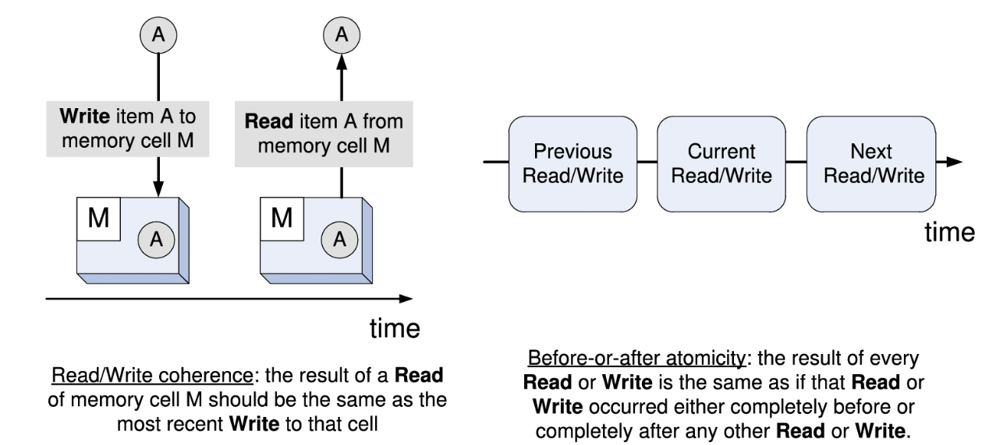
Cell Storage
Cell storage assumes that the storage consists of cells of the same size and that each object fits in one cell.
This model reflects the physical organization of several storage media; the primary memory of a computer is organized as an array of memory cells and a secondary storage device, e.g., a disk, is organized in sectors or blocks read and written as a unit.
Read/write coherence and before-or-after atomicity are two highly desirable properties of any storage model and, in particular, of cell storage;

Slide 7
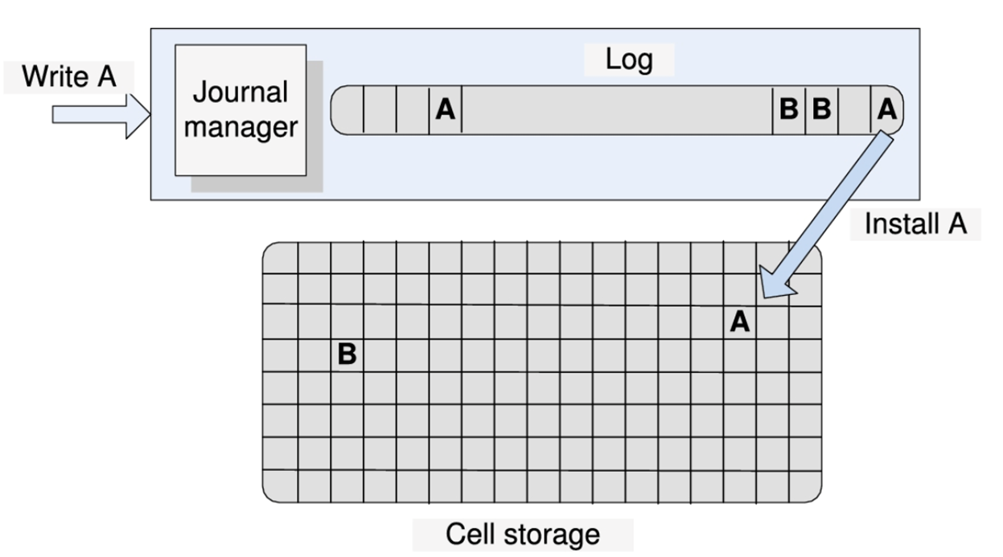
Journal storage
Journal storage is a fairly elaborate organization for storing composite objects such as records consisting of multiple fields.
Journal storage consists of a manager and a cell storage where the entire history of a variable is maintained, rather than just the current value.
The user does not have direct access to the cell storage, instead it can request the journal manager to: (i) start a new action; (ii) read the value of a cell; (iii) write the value of a cell; (iv) commit an action; and (v) abort an action.
The journal manager translates user requests into commands sent to the cell storage: (i) read a cell; (ii) write a cell; (iii) allocate a cell; and (iv) deallocate a cell.

Slide 8
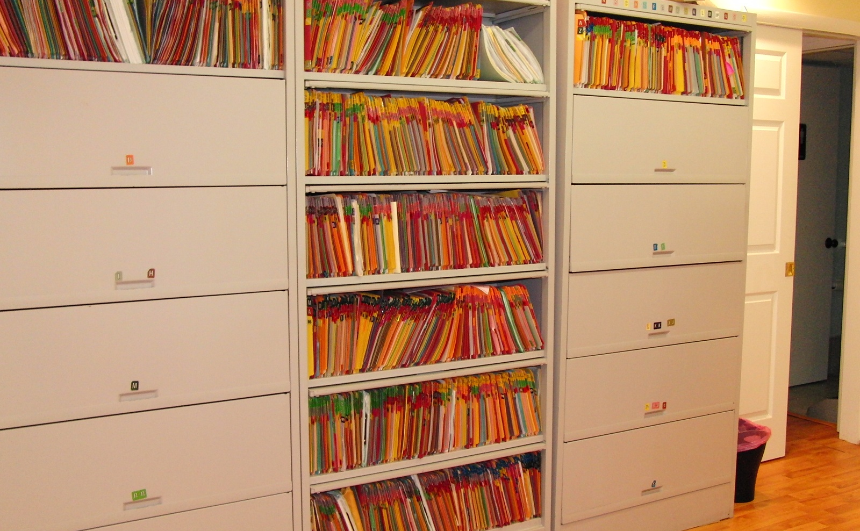
File system
A file system consists of a collection of directories and each directory provides information about a set of files.
High-performance systems can choose among three classes of file systems: Network File Systems (NFS), Storage Area Networks (SAN), and Parallel File Systems (PFS).
Network file systems are very popular and have been used for some time, but do not scale well and have reliability problems; an NFS server could be a single point of failure.
This Photo by Unknown Author is licensed under CC BY

Slide 9
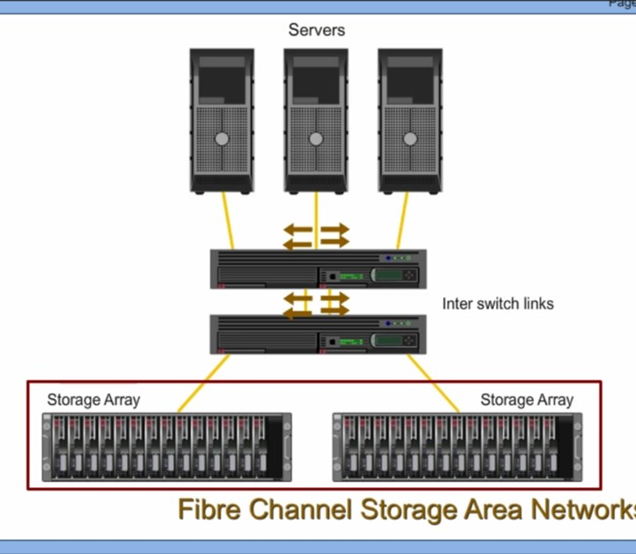
File system
SANs offer additional flexibility and allow cloud servers to deal with nondisruptive changes in the storage configuration.
SAN can be pooled and then allocated based on the needs of the servers; pooling requires additional software and hardware support and represents another advantage of a centralized storage system.
Parallel file systems are scalable, are capable of distributing files across a large number of nodes, and provide a global naming space. In a parallel data system, several I/O nodes serve data to all computational nodes; the system includes also a metadata server that contains information about the data stored in the I/O nodes.
This Photo by Unknown Author is licensed under CC BY

Slide 10
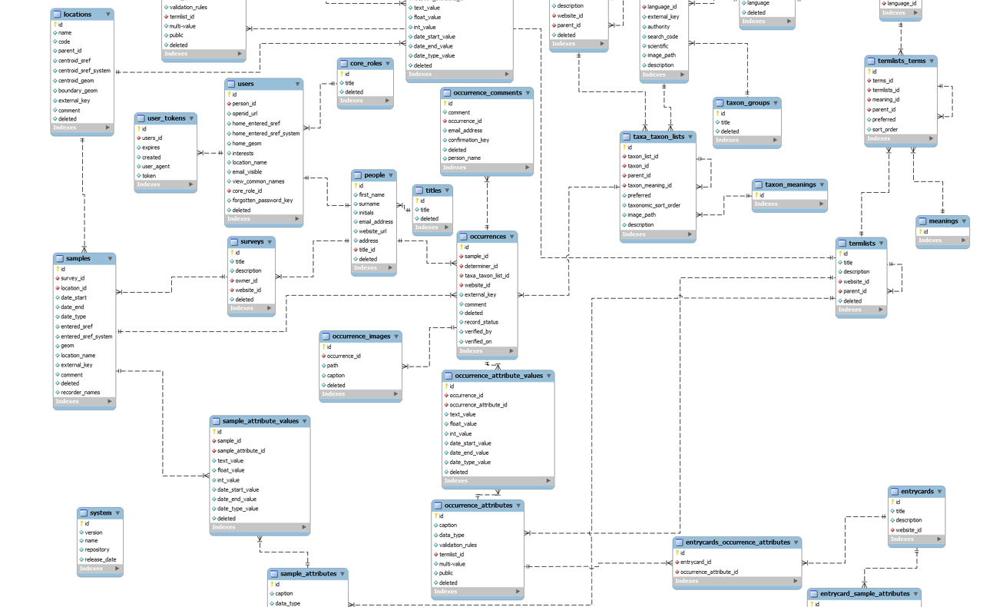
Databases
A database is a collection of logically related records
The software that controls the access to the database is called a Data Base Management System (DBMS).
The main functions of a DBMS are: enforce data integrity, manage data access and concurrency control, and support recovery after a failure.
A DBMS supports a query language, a dedicated programming language used to develop database applications.
This Photo by Unknown Author is licensed under CC BY-SA

Slide 11
Distributed File Systems

Slide 12
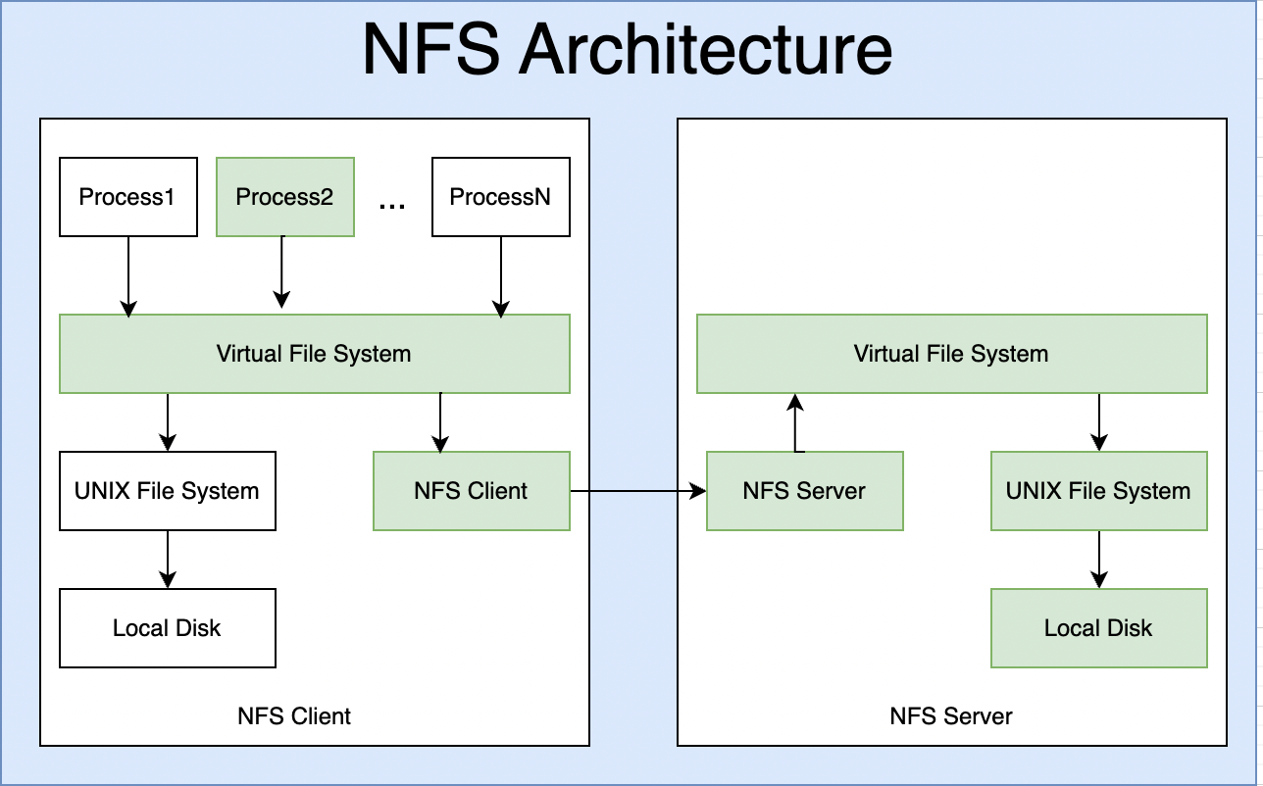
Network File System (NFS)
NFS was the first widely used distributed file system
the development of this application based on the client-server model was motivated by the need to share a file system among a number of clients interconnected by a local area network.
A majority of workstations were running under UNIX; thus, many design decisions for the NFS were influenced by the design philosophy of the UNIX File System (UFS).

Slide 13
Network File System (NFS)
Purpose of NSF
provide the same semantics as a local UFS to ensure compatibility with existing applications and facilitate easy integration into existing UFS;
ensure that the system will be widely used, thus support clients running on different operating systems; and
accept a modest performance degradation due to remote access over a network with a bandwidth of several Mbps.

Slide 14
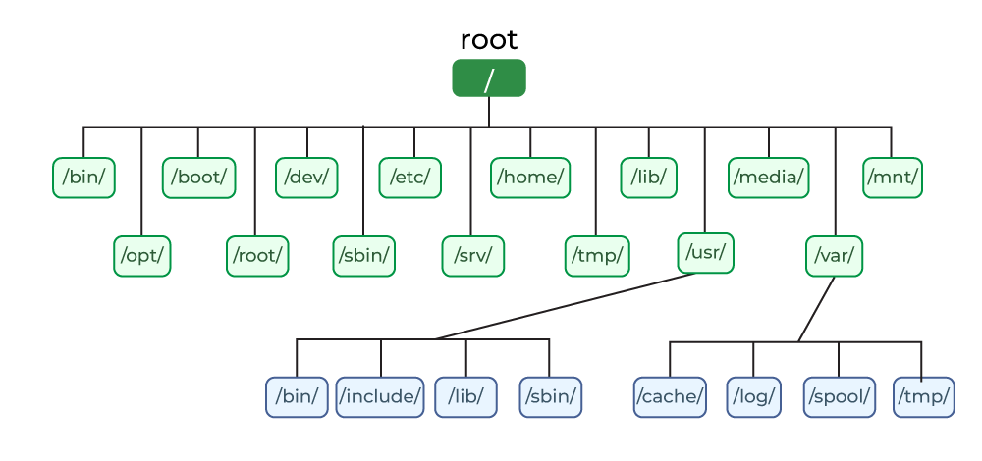
Unix File system
UFS is a logical method of organizing and storing large amounts of information in a way that makes it easy to manage.
A file is the smallest unit in which the information is stored. Unix file system has several important features. All data in Unix is organized into files. All files are organized into directories.
Files in Unix System are organized into multi-level hierarchy structure known as a directory tree.
At the very top of the file system is a directory called "root" which is represented by a "/". All other files are "descendants" of root.
Unix file system also uses a set of permissions to control access to files and directories.

Slide 15
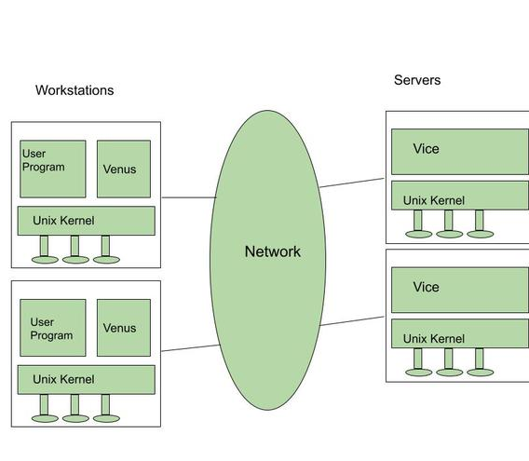
Andrew File System (AFS)
AFS is a distributed file system developed in the late 1980s at Carnegie Mellon University in collaboration with IBM.
System designers envisioned a very large number of workstations interconnected with a relatively small number of servers. It was anticipated that each individual at CMU would have an Andrew workstation, thus the system would connect up to 10000 workstations.
The set of trusted servers in AFS form a structure called Vice. The workstation OS, 4.2BSD UNIX, intercepts file system calls and forwards them to a user-level process called Venus which caches files from Vice and stores modified copies of files back on the servers they came from.
Notes:
Reading and writing operations are performed directly on the cached copy of the file and bypass Venus. Only when a file is opened or closed does Venus communicate with Vice.
The emphasis of the AFS design is on performance, security, and simple management of the file system. The local disk of a workstation acts as a persistent cache ensuring scalability and reducing the response time.
The master copy of a file residing on one of the servers is updated only when the file is modified. This strategy reduces the server load and improves the system performance.
Another major objective of the AFS design is improved security. The communications between clients and servers are encrypted, and all file operations require secure network connections.

Slide 16
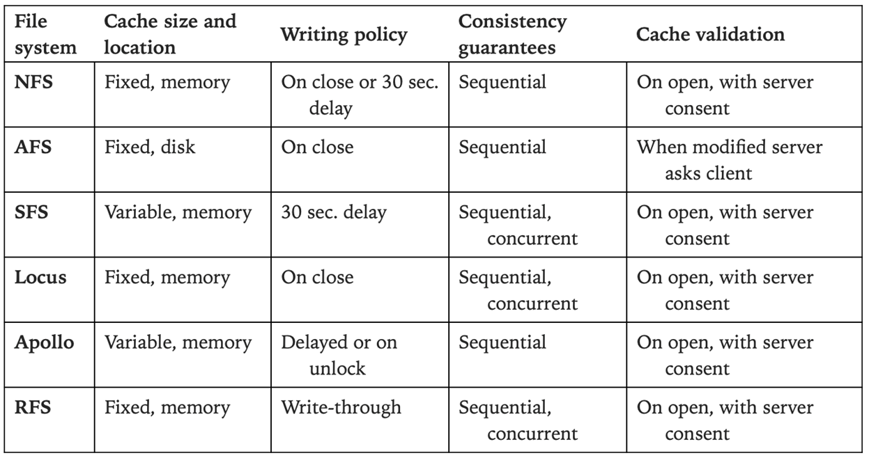
Comparison of several network file system

Slide 17
noSQL database

Slide 18
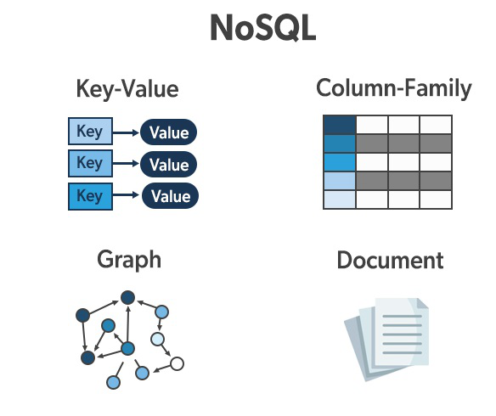
Nosql database
NoSQL refers to a set of databases developed in late 1990s that do not rely on the relational model.
NoSQL databases differ from each other, run well on large clusters, and are open source.
NoSQL schema is defined implicitly by the way application code utilizes the database.
NoSQL does not reflect an advance in storing technology, rather a response to practical needs to efficiently access very large datasets stored on large computer clusters.

Slide 19

NoSQL Distribution Models
The distribution model is based on an aggregate data model that eliminates the relations and transactions
of the relational model in favor of more complex data structures allowing lists and other record structures to be nested. The aggregate structures are naturally replicated and sharded; storing relevant data on the same storage server minimizes the number of servers accessed to respond to a query. The NoSQSL distribution models are:
sharding;
master–slave replication; and
peer-to-peer (P2P) replication
Notes:
Sharding is based on horizontal scalability; the data is distributed to the servers aiming to balance the workload. The aggregates are stored together if accessed together; the aggregate distribution to storage servers may change over time in response to access pattern changes. Sharding optimizes the writes.
Master–slave replication designates one server as master and all other storage servers as slaves. The master is responsible for processing updates and is the authoritative data source. Servers are synchronized with the master. A drawback of this distribution model is inconsistency as updates take time to propagate from the master to the slaves. This distribution model is optimal for read-intensive database applications and horizontal scaling because new slaves can be added easily.
P2P systems are the most democratic; servers have the same functionality and accept write operations; and loosing one or a few servers may affect performance but not system functionality. The price to pay is potential lack of consistency; a write-write conflict is unavoidable when a record is updated on two different servers at the same time.

Slide 20
NoSQL Database Types
Key-value. This type of NoSQL databases model data as an index key and a value, similar with hash tables. Access to database is via primary key. Modeling relationships among different sets of data, correlating data with different sets of keys, searching based on the value of the key-value pair, and operations on sets are not recommended for key-value databases.
Document databases. Similar to key-value, but the value associated with a key contains structured or semistructured data. These databases enjoy a number of useful features such as: (i) ability to query data in the document without having to retrieve the whole document by key; (ii) support nested documents within the value field. Document databases should not be used for complex transactions spanning different operations because atomicity is only guaranteed within a single document, not across documents.

Slide 21
NoSQL Database Types
Column-family databases. Such databases store large sparse tables with a very large number of rows and only a few columns. They store data in column families as rows. Several columns are associated with a row key for data often accessed together. Super “columns consist of a map of columns; there are also super column families.
Graph databases. In graph databases, the vertices represent entities, and the directional edges represent relationships among the entities. The graphs are meant to be stored with a single organizational structure and then interpreted in different ways based on the relationships. Scaling graph databases is different than for aggregate-oriented models, and sharding is difficult because the nodes are relationship-oriented rather than aggregate-oriented. Horizontal scaling is ineffective for graph databases, only vertical scaling is suitable.

Slide 22
NoSQL Database Types
Cloud stores such as document stores and NoSQL databases are designed to scale well, do not exhibit a single point of failure, have built-in support for consensus-based decisions, and support partitioning and replication as basic primitives.
Systems such as SimpleDB, CouchDB (http://couchdb.apache.org/), or Oracle NoSQL database are very popular, though they provide less functionality than traditional databases.
The key-value data model is very popular. Several such systems including Voldemort, Redis, Scalaris, and Tokyo cabinet are discussed in.

Slide 23
Disk Locality Versus Data Locality in Computer Clouds

Slide 24
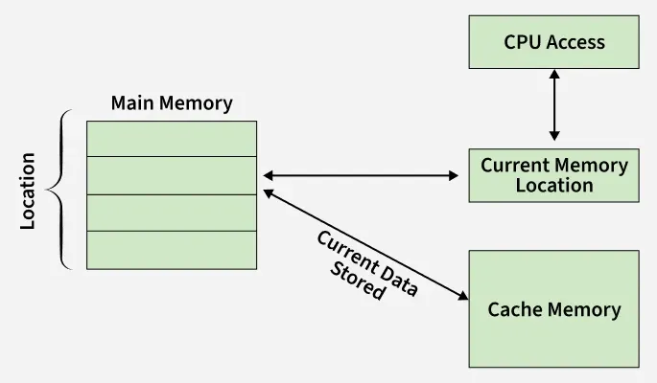
Locality
Locality has major implications for memory hierarchies. The performance of a processor is highly dependent on the ability to access code and data in the cache rather than memory.
Virtual memory can only be effective if the code and the data exhibit spatial and temporal locality so that page faults occur infrequently.
Locality improves the performance of cloud applications for two main reasons:
disk bandwidth is larger than the network bandwidth, and the off-rack communication bandwidth is oversubscribed and affects the off-rack disk access; and
(ii) the better performance of I/O-intensive applications, when data is stored locally, is due to the lower latency and the higher bandwidth of a local disk versus the latency and the bandwidth of a remote disk.

Slide 25
Locality
Why store on disk then load to memory
There are several reasons on that, mainly speed, latency, cost
Networking technology improves at a faster pace than hard disk technology.
The bandwidth available to applications will increase as data centers adopt bisection topologies for their interconnects.
The latency of a read access to a local disk is only slightly lower than the latency of a read to a disk in the same rack; local disk access is about 8% faster.
Though the cost of solid-state disk technology is dropping at a impressive rate, i.e., 50% per year, solid-state disks are unlikely to replace hard disk drives any time soon due to the sheer volume of data stored on computer clouds.
Accessing data in local memory is two orders of magnitude faster than reading from a local disk.
There is at least a two orders of magnitude discrepancy between the capacity of the disks and the memory of today's clusters.

Slide 26
Exercise
Compare noSQL DB and SQL in terms of speed and cost of operation

Slide 27
References
Marinescu, Dan C. (2022). Cloud Computing Theory and Practice: 3rd Edition. Morgan Kaufmann Publishers. ISBN: 978-0-323-85277-7

Slide 28
Thankyou

